Slide 1
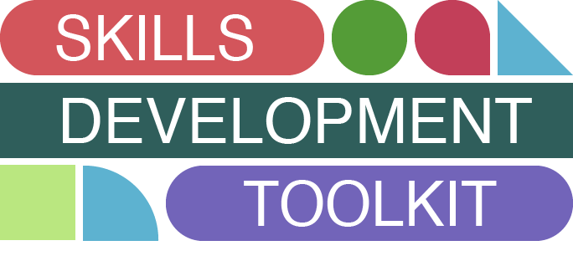

Slide 2
How to use this é toolkit
This ‘Digital Marketing Teams – Skills Development Toolkit’ is designed to help you identify your organisation's digital skills strengths, where there are development opportunities, and how you can work to improve any areas of weakness to help meet your organisation's objectives.
The toolkit will take you through several tools and resources that can be used to benchmark your skills and analyse your current capabilities, which will allow you discover areas for improvement.
We have outlined a process for managers and for one team members to complete. These will score your digital capability as an organisation and as individuals and identify where the skills gaps are.
Make sure to note down any thoughts, observations or findings in the ‘plan’ at the end of the process so you can use this to analyse how you will move forward.

Slide 3
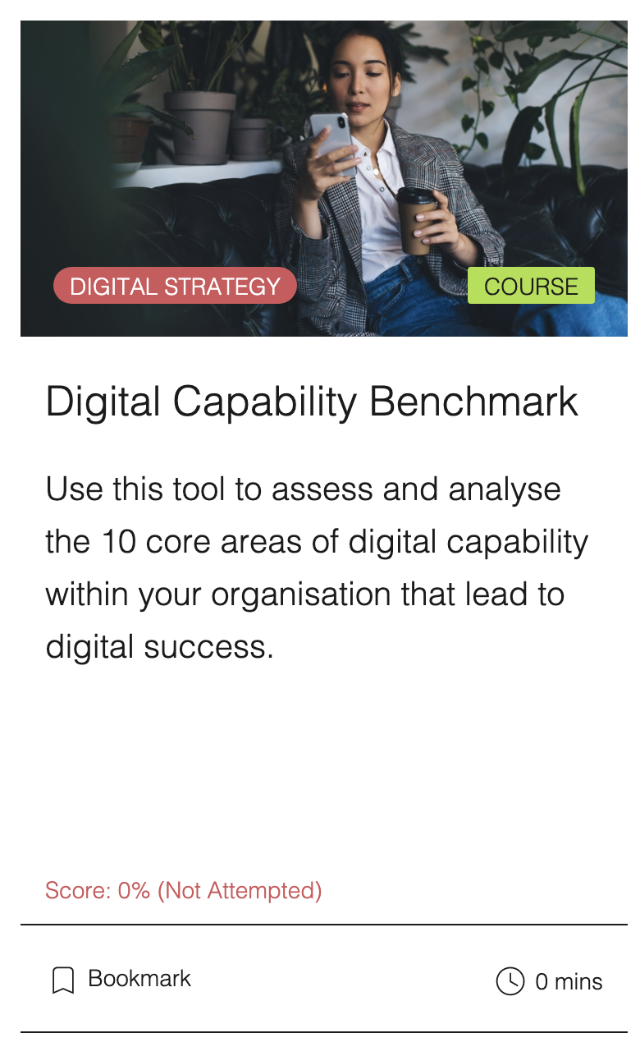
ø Digital Capability Tool
The Target Internet Digital Capability Tool is designed to help you assess and analyse the ten core areas of digital capability within your organisation that lead to digital success. The tool looks at what digital capability is and how it connects to digital transformation. It will then go through and look at a model that explores the ten key areas of digital capability, and in each of these sections you’ll be able to score your own organisation. At the end, you’ll receive a benchmark analysis and see where your organisation scores against others. To access the Digital Capability Tool and many other useful resources for free, visit targetinternet.com

Slide 4
ü Digital Capability
ü Essentials
¥ Readiness
é Performance
Manage
Manage
Leadership Buy-in
Team Ability
Market Readiness
Resources
Strategy
Governance
Infrastructure
Measurement
Financial
Innovation

Slide 5
î Digital Marketing Tactical Capability
This is a Digital Capability model, initially developed as part of the Digital Transformation framework for the award winning book Building Digital Culture, and as used by Imperial College Business School for their MBA, MSc and executive education programmes.
The model is based on research into what makes an organisation succeed or fail in their digital transformation efforts.
We have expanded this model to show what Digital Marketing Capabilities are required to be able to apply a best practice approach to your digital marketing activity. You can use this to benchmark your current situation and analyse what areas need improvement.
The difference between Digital Capability and Digital Marketing Tactical Capability, is that Digital Capability looks more broadly at complete organisational capability and may include issues like HR, Finance etc. as well as organisational culture, integration and process. Digital Marketing Capability looks specifically at what is needed in each of these areas to be able to implement best practice digital marketing activity.

Slide 6
Digital Marketing Tactical Capabilities – ü Essentials
Digital metrics are used to help strategic planning. Leadership are fully bought-in, understand the challenges of digital marketing and encourage adoption on new approaches and experimentation. Marketing update and educate leadership on a regular basis.
Leadership Buy-in
We have clearly defined skills requirements for different roles. We have clearly defined approaches to upskilling and team development and have approaches in place to make sure we explore new tools, techniques and technologies.
Team Ability
We have built marketing personas that accurately reflect our target audiences characteristics and behaviour. These personas are built on data, not opinion, and are regularly updated. We have access to information sources to keep these insights up to date and regular speak to our customers and target audience.
Market Readiness
We have sufficient resources to apply our digital marketing strategy and tactical plans including people, time and budgets. We have put in place a range of tools, techniques and processes that allow us to maximise our effectiveness and efficiencies.
Resources

Slide 7
Digital Marketing Tactical Capabilities – ¥ Readiness
Our strategy is developed based on insights from our target audience, user journey and digital marketing KPI’s. We take an agile approach to strategy that allows us to constantly develop and iterate our strategy.
Strategy
We have clearly defined process that allow us to sign off content and changes to our digital activity quickly. Our teams understand each other’s roles and working practices. We use agile methodologies and cross disciplinary teams where necessary. We have process and tools in place for social media monitoring, analytics analysis and campaign iteration. We have clearly defined policies in all areas of digital marketing.
Governance
Our systems are fully integrated so we can achieve a Single Customer View. This includes the integration of CMS, CRM, ESP and marketing automation platforms. Our technology enables a fully mapped out user journey with optimised customer experience across channels.
Infrastructure
We can measure all of our channels, web and CRM activity and bring this data into dashboards that are appropriate for the teams that need access to this data. We have analytics analysis processes in place and use our data to inform our tactical activity and future strategic planning.
Measurement

Slide 8
Digital Marketing Tactical Capabilities – é Performance
We can prove the impact of our tactical activity on our desired outcomes. We use a combination of analytics, dashboards and attribution modelling to achieve this. This performance is used to feedback and iterate both our tactical activity and strategic planning
Financial
We embrace and test new tools, techniques and technologies quickly. We have processes in place to ‘scaffold’ and encourage this innovation. Any learning from testing is documented and shared across teams.
Innovation

Slide 9
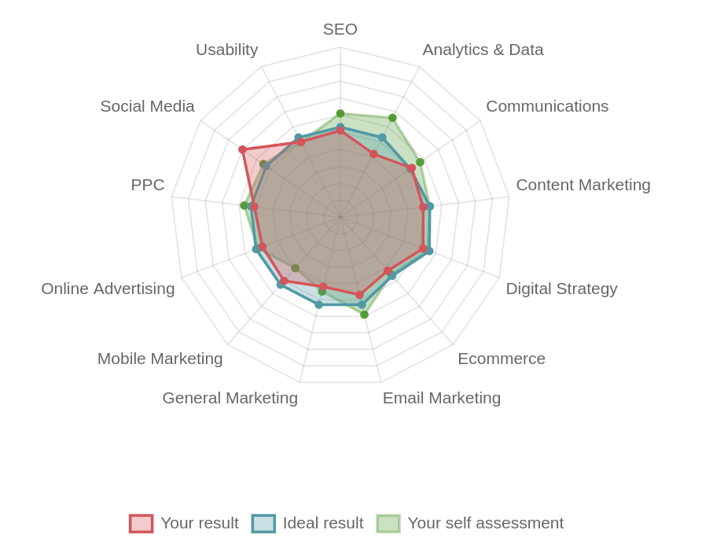
The Digital Marketing Skills î Benchmark
Our Digital Skills Benchmark assesses your team’s digital skills in a variety of digital marketing disciplines, against industry standards and best practice, according to main focus, level of seniority and industry sector.
Our experts have formulated a series of questions, based on industry best practice as determined by leading industry institutions like Google and the Chartered Institute of Marketing, to assess your team’s skills and identify their digital skills gaps.
The Digital Marketing Skills Benchmark is the only study of its type and scale that looks at skills across a wide range of industries and levels of seniority. Rather than being opinion based like many other studies, the core of the benchmark assesses the skills of thousands of individuals.

Slide 10
ø The results
Each individual will see a spider chart that represents where their skills are in relation with the markers selected (seniority, focus of your role, industry). We will also aggregate the data and provide you with an overall visualisation of your team.
We provide individuals with a short written analysis of their results highlighting their strengths and where their skills gaps are. We also provide you with a group analysis and a comparison with aggregated data of other organisations in the same country.
The digital skills benchmark covers a wide range of digital topics and very from beginner to advanced level questions. If you do not know the answer to a question DO NOT GUESS as this will skew the benchmark results – simply select “Not sure”.

Slide 11
Download our latest å Digital Marketing Skills Benchmark report

Slide 12
The process for ü Managers

Slide 13
ü Organisational challenges
Think about your business goals – what are you trying to achieve? What are the organisational challenges and what is stopping you from overcoming these challenges?

Slide 14
î Current capability analysis
Complete the Digital Capability Tool (refer to page 5) and record your scores from each digital capability category.
é Topic | ø Score
Leadership Buy-In
Team Ability
Market Readiness
Resources
Strategy
Governance
Infrastructure
Measurement
Financial
Innovation

Slide 15
Digital marketing tactical capability – ü Essentials
Use the next few pages to assess what you need to improve to be able to apply a best practice approach to your digital marketing activity.
 | What we need to improve
Leadership Buy-In
Team Ability
Market Readiness
Resources | .

Slide 16
Digital marketing tactical capability – ¥ Readiness
 | What we need to improve
Strategy
Governance
Infrastructure
Measurement | .

Slide 17
Digital marketing tactical capability – é Performance
 | What we need to improve
Financial
Innovation

Slide 18
î Skills
What skills do you need across your team in order to overcome your challenges? Where are the digital capability gaps? What Digital Marketing Tactical Capability areas need improving and what skills do you need to do this?

Slide 19
Skills development plan – for å Managers
Use the information on the previous slides to fill out this plan
 | What are the skills needed to overcome challenges? | What are the digital capability gaps within your organsation? | What sections of the Digital Marketing Tactical Capability need improvement and how do you plan to develop these areas?
What are your organisational objectives? | What is your current situation? What were your Digital Capability scores? | What steps are you going to take to develop these skills within your team? | You can ¥ retake the Digital Capability Tool questions anytime to measure how much you have ø improved as an organisation.
Name
Position

Slide 20
The process for ¥ Team Members

Slide 21
ü Objectives
Think about your objectives – what are you trying to achieve? What is stopping you from achieving this?

Slide 22
î Your current situation
Use our Digital Skills Benchmark (refer to page 10 & 11) to help determine your current skillset and where there is room for improvement. Insert a picture of your results diagram and analysis in the box below.

Slide 23
é Your organisation’s situation
Complete the Digital Capability Tool (refer to page 5) and record the scores from each digital capability category. This helps assess how you ‘digitally capable’ you understand your organisation to be.
é Topic | ø Score
Leadership Buy-In
Team Ability
Market Readiness
Resources
Strategy
Governance
Infrastructure
Measurement
Financial
Innovation

Slide 24
å Skills
What skills do you need in order to help you achieve your objectives? Did the Digital Skills Benchmark highlight these skills as an area for development?

Slide 25
Skills development plan – for é Team members
Use the information on the previous slides to fill out this plan
 | How did you score on the digital capability quiz? | What skills do you need in order to meet your objectives? | What methods of learning would you like to explore to help you enhance these skills? Keep those that apply. Refer to our Ultimate Guide to Digital Marketing Training Report for pros and cons of each method. Classroom Based Training Digital Marketing Qualifications Elearning/Online Interactive Training Webinar/Real-time Online Training Workshops/Hackathons Conferences Seminars Informal Learning Blended Learning – Brining it all together
What are your objectives? | How did you perform on the Digital Skills benchmark? | What steps are you going to take help develop these skills? | You can ¥ retake the Digital Capability Benchmark anytime to measure how much you have ø improved.
Name
Position

Slide 26
Chartered Institute of Marketing (CIM) Certificates
Interactive courses
Extensive library of content
Constantly updated
Used by prestigious academic institutions and some of the world’s leading organisations
Learn at your own pace
Engaging content
Created by recognised industry experts
Online digital marketing å courses and ¥ certifications
for teams
Give your team the support to master the fundamentals of digital marketing, achieve certification and stay up to date with our industry endorsed online training courses.

Slide 27
The é ultimate guide to digital marketing training
The Ultimate Guide to Digital Marketing Training Report is our complete guide to bridging the digital skills gap.
The report outlines the key ways in which teams and individuals can improve their digital marketing skills and then keep them up to date. It includes analysis of demand for digital marketing training, a summary of key solutions and an in-depth guide to different training solutions and approached.
¥ The report covers
The Digital Skills Gap
Digital Marketing Training and Jobs
Global Digital Marketing Skills Shortage
Digital Marketing Training: The Solutions
Classroom Based Digital Marketing Training
Digital Marketing Qualifications
E-Learning/Online Interactive Training
Webinar/Real-time Online Training
Workshops/Hackathons
Conferences
Seminars
Informal Learning
Blended Learning – Brining it all Together
Download the report

